Slide 1
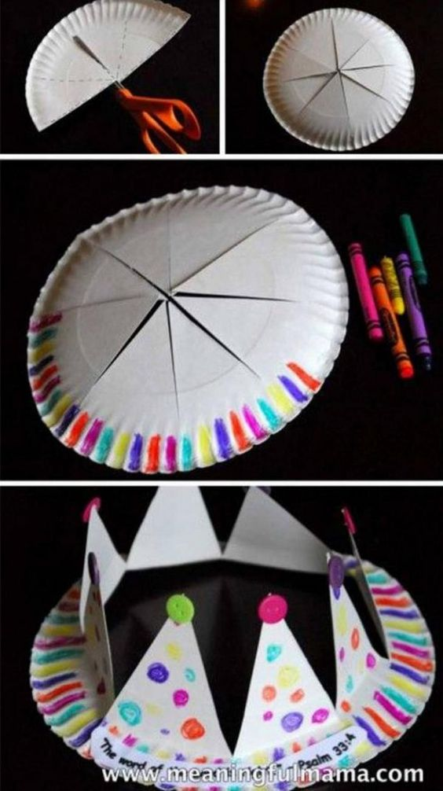
MAD HATTER
Hat 1 of 3:
MAKE A CROWN!
SUPPLIES:
Paper Plate
Pencil
Scissors
Markers, Crayons, or Paints
To create the crown, simply follow the steps in the pictures to the left!

Slide 2
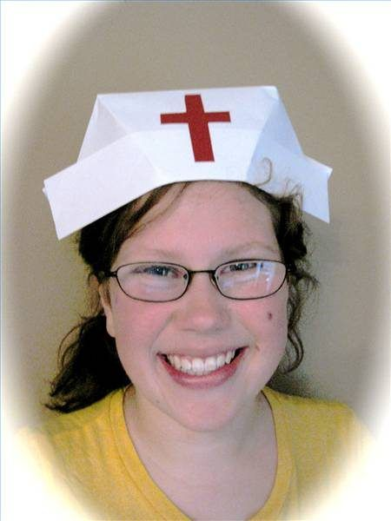
MAD HATTER
Hat 2 of 3:
Make a Nurse Cap (or omit the red cross and make it any kind of cap you choose!)
Supplies:
2 sheets of white paper 8.5 x 11
Glue stick
Scissors
There will be 7 steps…..
This project was brought to us from eHow!

Slide 3
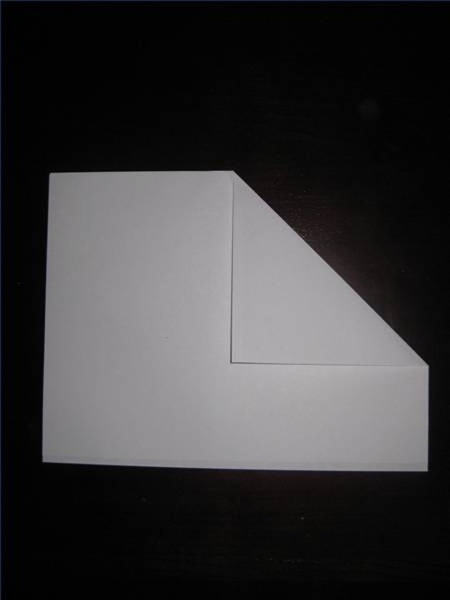
MAD HATTER
Step One: Attach two pieces of 8 1/2-inch by 11-inch white paper together along the short edge.
Step Two: Fold paper in half, having the folded edge at the top.
Step Three: Find the center of the paper; fold the upper-right-hand corner down along the center, leaving about a 2-inch border along the bottom.

Slide 4
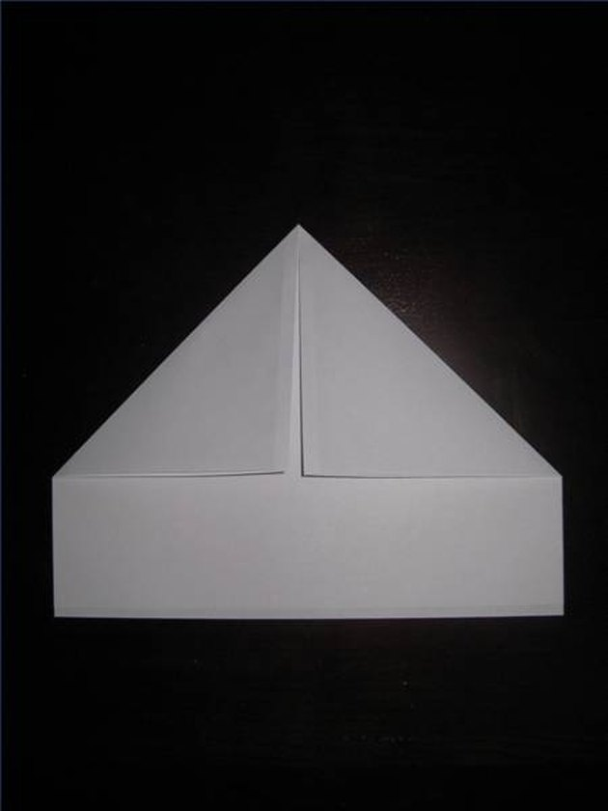
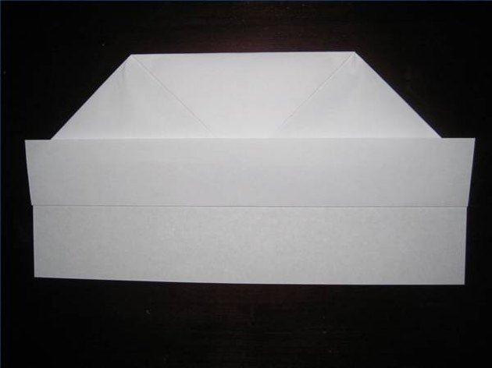
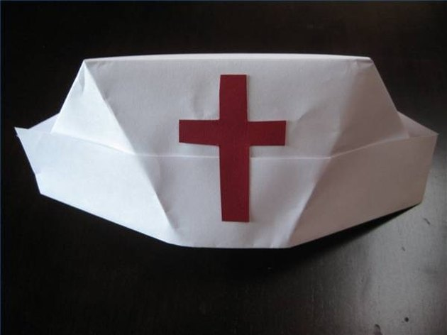
MAD HATTER
Step Four: Repeat with the upper left hand corner. You should end up with a triangle and a 2-inch border along the bottom edge.
Step Five: Fold the tip of the triangle down to meet the edge that was formed by the triangle piece. You should still have a 2-inch border along the bottom edge. You may glue this piece down, if desired.
Step Six: Grabbing the bottom edge of the top layer only, fold up the 2-inch border. Turn the hat over and repeat on the other side.
Step Seven: Open the hat, manipulating it gently to shape it and form light creases. Embellish the front, as desired.

Slide 5
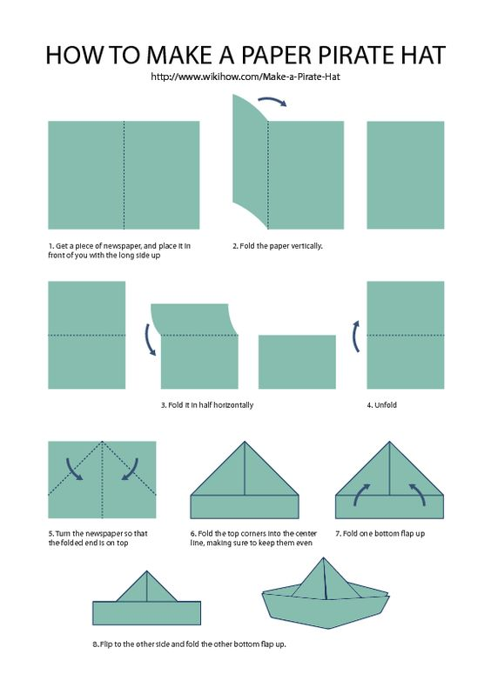
MAD HATTER
Hat 3 of 3:
Make a pirate hat!
Supplies:
One large sheet of drawing paper or news paper
Follow instructions on graphic to the left!

