Slide 1
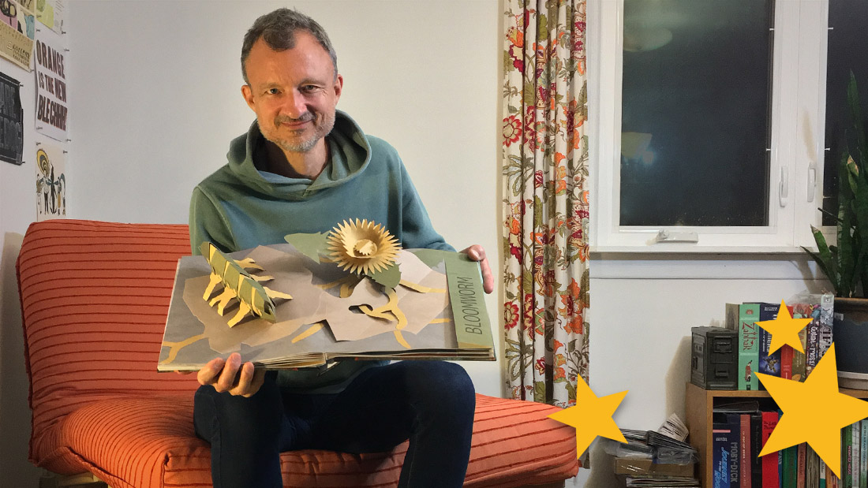
CUT, FOLD, and POP!
Origami is the Japanese art of paper folding. It started in the 17th century and became very popular in the mid 1900s.
Pop-ups also became popular for kids in the USA during the mid 1900s, but their origin traces all the way back to the 1200s with the invention of the Lullian Circle in the kingdom of Majorca.
For Inspiration, click here:
https://www.shawnsheehy.com/
https://www.bestpopupbooks.com/
https://mymodernmet.com/contemporary-origami-artists/
Shawn Sheehy
For Projects and instructions, head on over to the next page

Slide 2
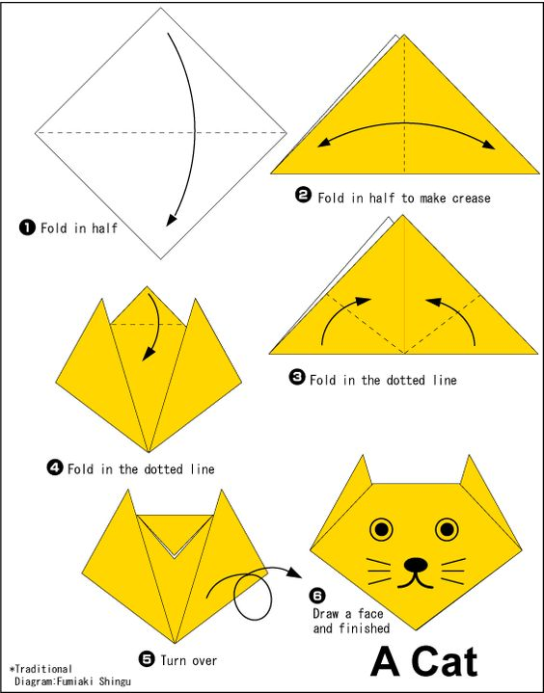
CUT, FOLD, and POP!
Here is a fun folding project by origami-amazing.blogspot.com
SUPPLIES:
1 6” square piece of paper
A marker or pen
Follow the instructions on the graphic to the left.
MORE PROJECTS

Slide 3
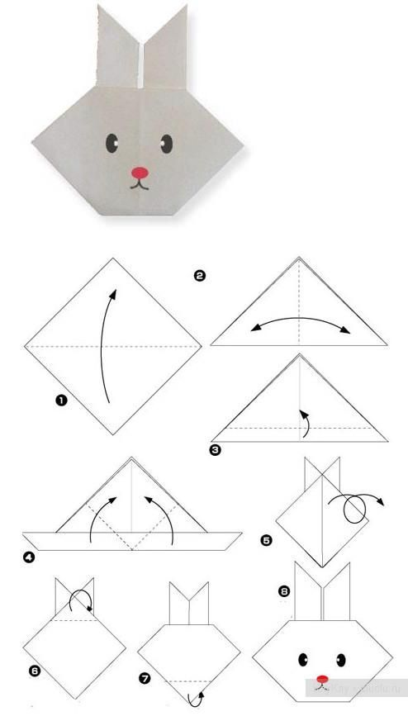
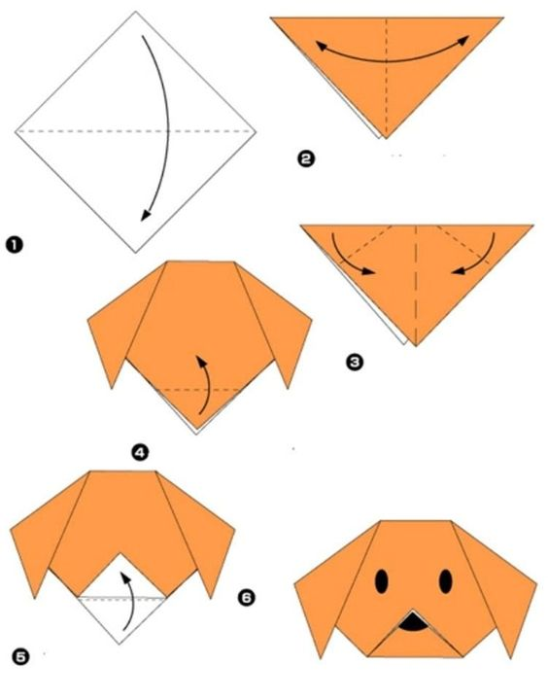
CUT, FOLD, and POP!
If the cat wasn’t enough,here is a dog and a rabbit you can fold from a square piece of paper!
Follow the instructions on the graphic!
More projects

Slide 4
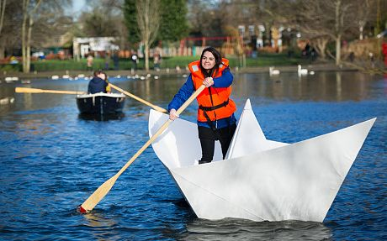
CUT, FOLD, and POP!
Once you have mastered the animal faces, you are ready to make a boat! We didn’t have a sheet of paper big enough to make this one from Helen Hiebert, but you can make one just like it in miniature.
SUPPLIES:
One sheet of 8.5 x 11 paper
MAKE A BOAT!
For video instruction, click here:
https://www.thesprucecrafts.com/easy-origami-boat-instructions-4057416
More Projects

Slide 5
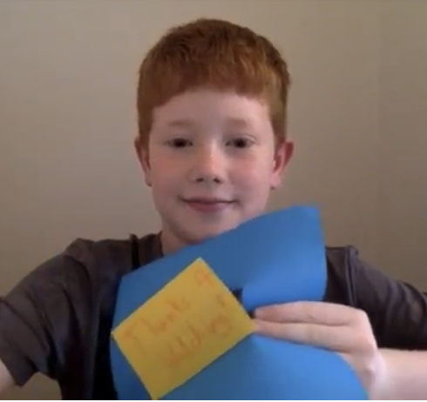
CUT, FOLD, and POP!
Pop-up card style one:
SUPPLIES:
Pen or Marker
Two sheets of different colored paper 8.5 x 11
Glue stick
Scissors
INSTRUCTIONS:
https://www.youtube.com/watch?v=hBGLyjraKbs
One more project

Slide 6
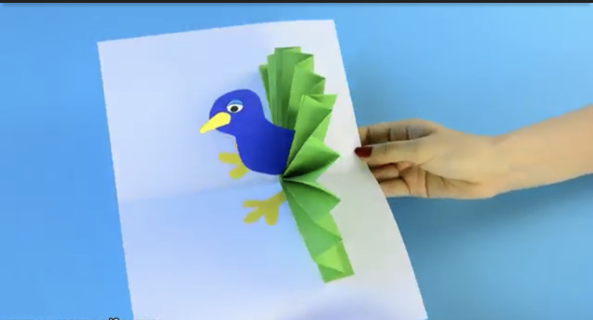
CUT, FOLD, and POP!
Pop-up card style two:
SUPPLIES:
Pen or Marker
Four sheets of different colored paper 8.5 x 11
Glue stick
Scissors
INSTRUCTIONS:
https://www.youtube.com/watch?v=ehki9RFBf5o

