Slide 1
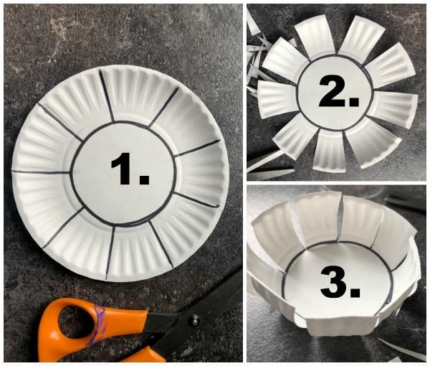
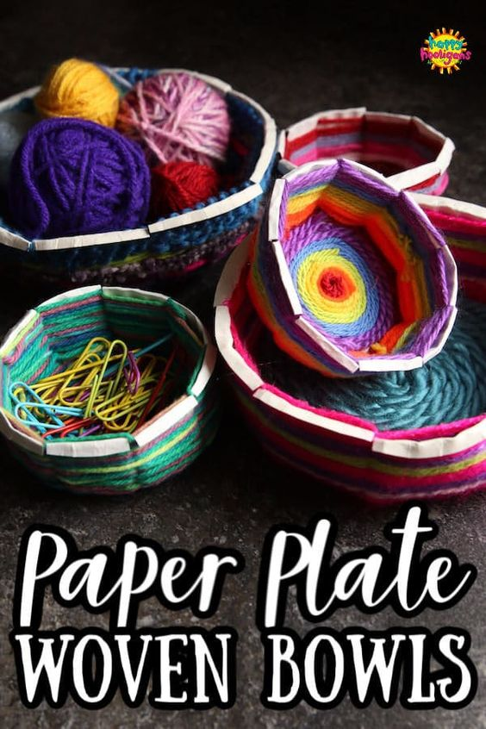
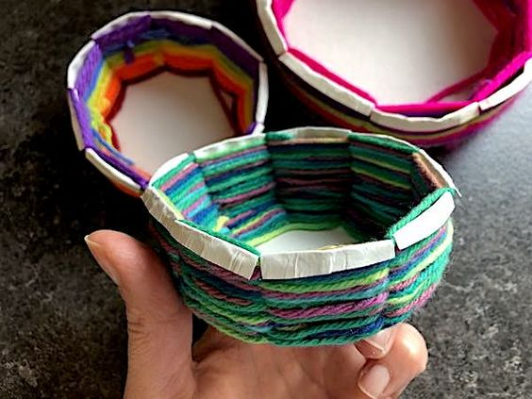
UN-DE-WEAVE-ABLE
Supplies:
Paper Plate
Pencil
Yarn
Scissors
Glue
Something round to trace
Click Here for video instruction:
https://happyhooligans.ca/paper-pl ate-woven-bowls/
Click Here for inspiration:
https://www.artsy.net/article/artsy-editorial-7-artists-weaving-new-tapestry-traditions

