Slide 1
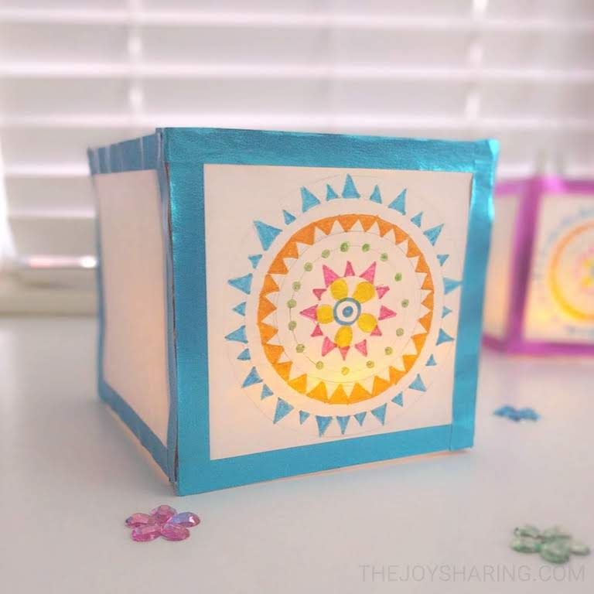
LANTERN
SUPPLIES:
Popsicle sticks
Washi tape
Tracing paper
Scissors
Pencil
Markers or Paint
Hot glue
Tealight

Slide 2
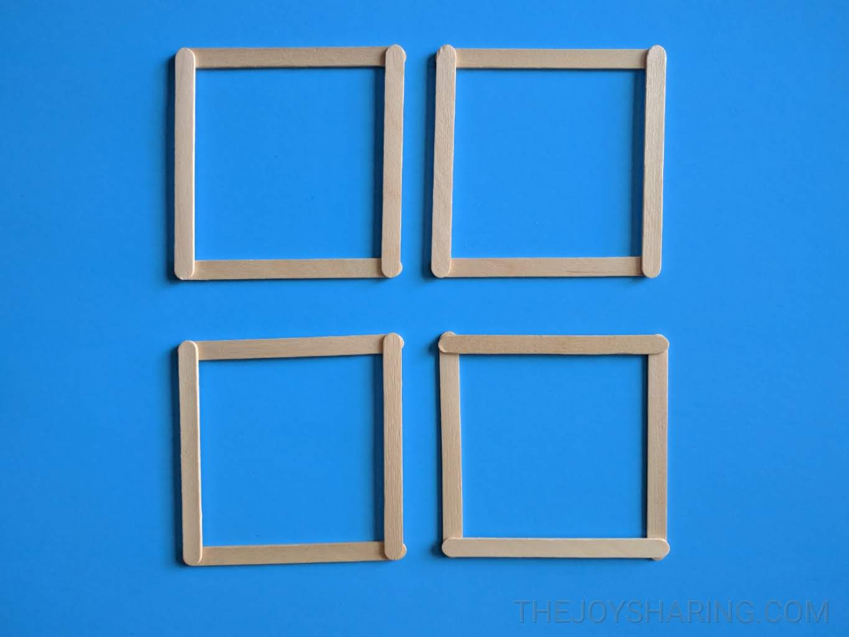
LANTERN
Step One:
Glue four popsicle sticks together to make the sides of the lantern.
If you want to add the base to the lantern, make one more popsicle stick square.

Slide 3
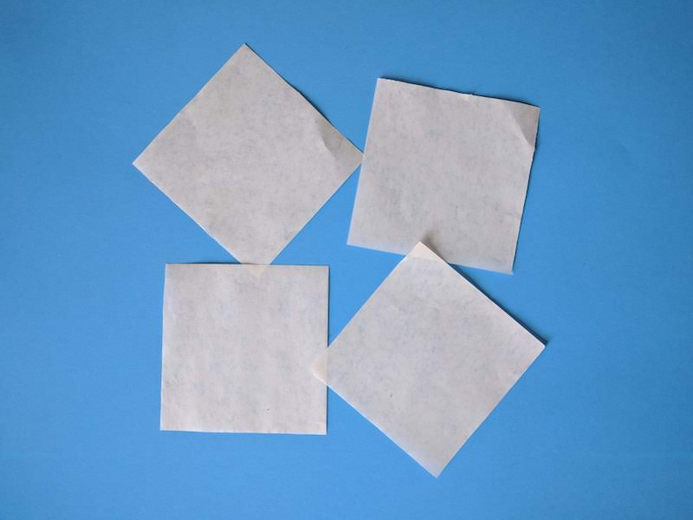
LANTERN
Step Two:
Cut 4 square pieces of tracing paper the same size as the popsicle stick squares.

Slide 4
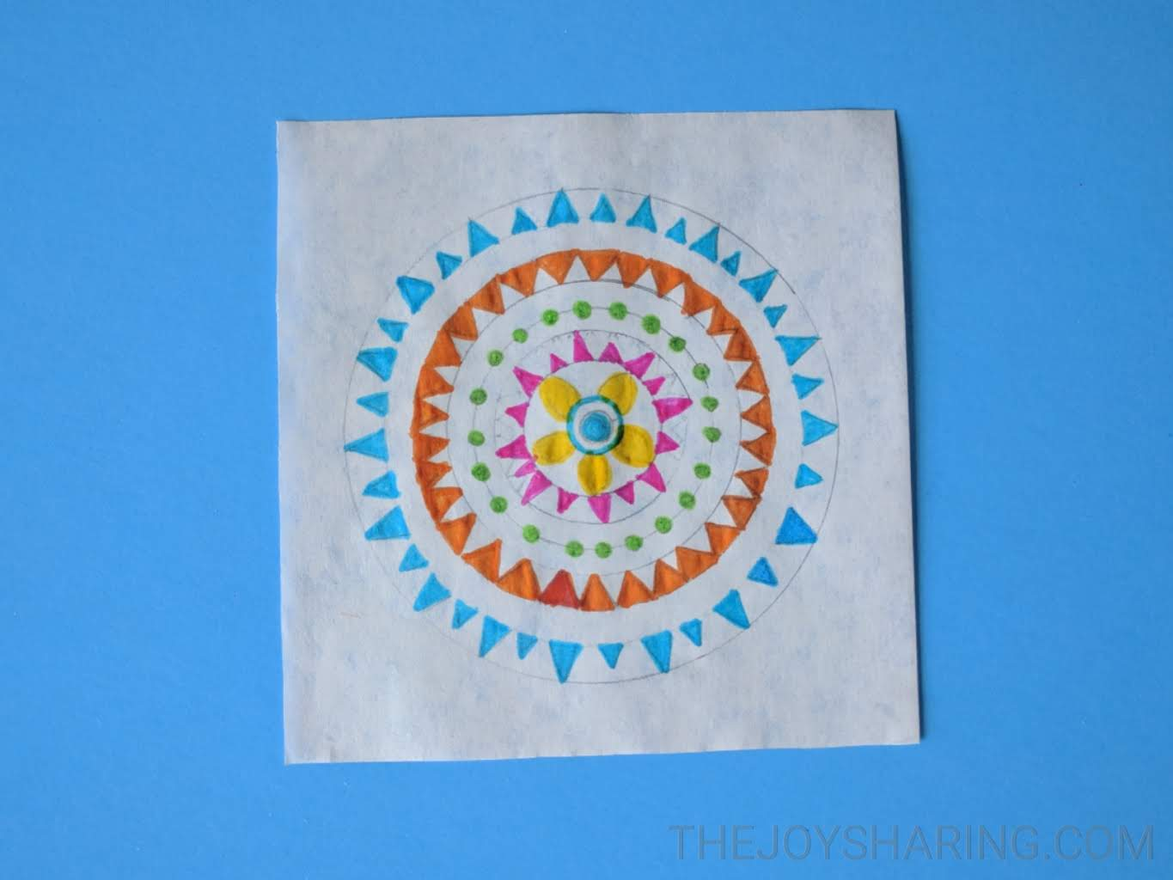
LANTERN
Step Three:
Make your drawing or painting on each piece of tracing paper.

Slide 5
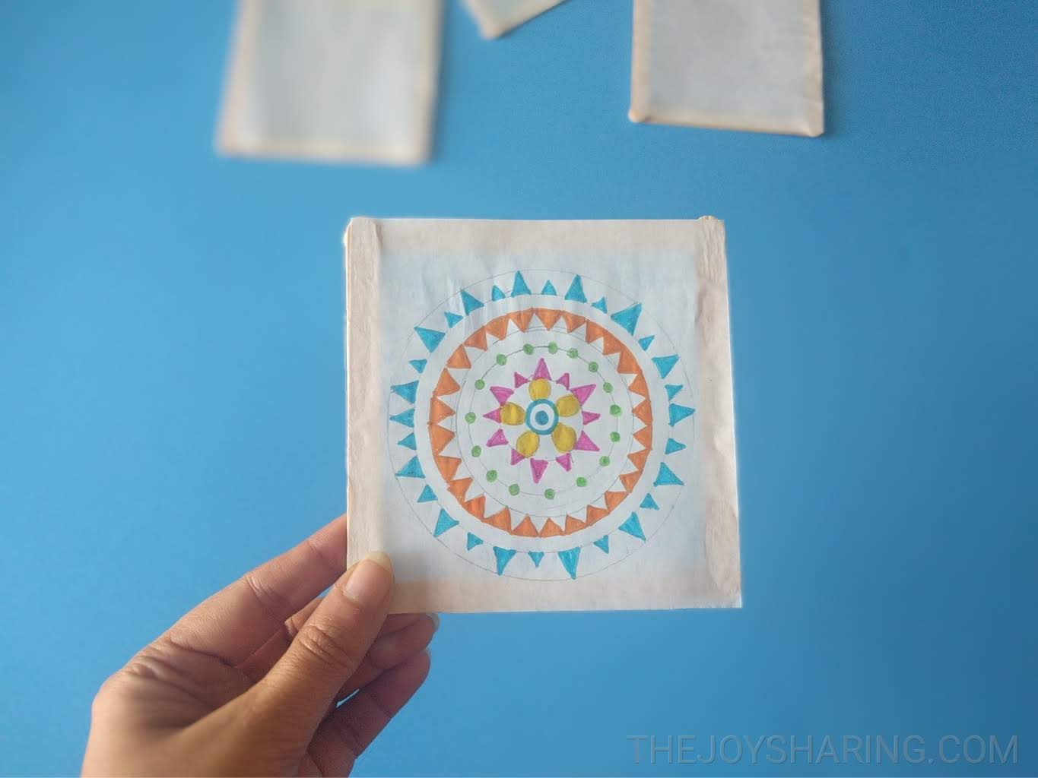
LANTERN
Step Four:
Glue the tracing papers to the wood stick squares.

Slide 6
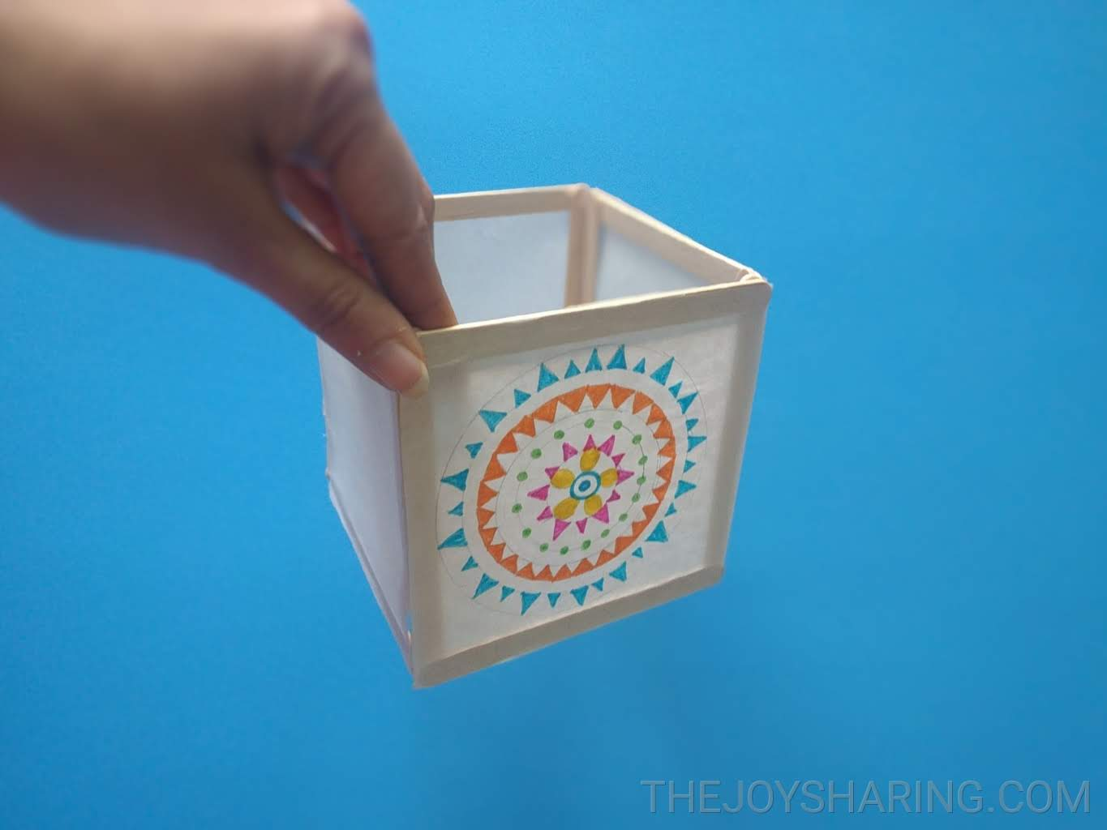
LANTERN
Step Five:
Glue the sides together using a hot glue gun. You can also regular white glue - It just takes little extra time to dry.

Slide 7
LANTERN
Step Six:
Decorate the lantern edges with washi tape. Place an LED tealight candle inside it and you are all set

